Slide 1
Forward Gravity modelling of 2D arbitrary-shaped bodies
Project By :
Arindam Barman(23N0012)

Slide 2


Forward modeling of gravity anomaly for 2-D bodies
Algorithm : Vertical component of gravity is computed by approximating the periphery of any 2-D body closely by a n-sided polygon.
The vertical component of gravity
where,
Source :Rapid Gravity Computations for Two-Dimensional Bodies….Talwani et al.

Slide 3

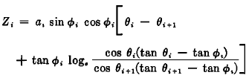
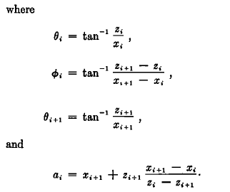
The polygon approximation
Total vertical component of gravity
and

Slide 4
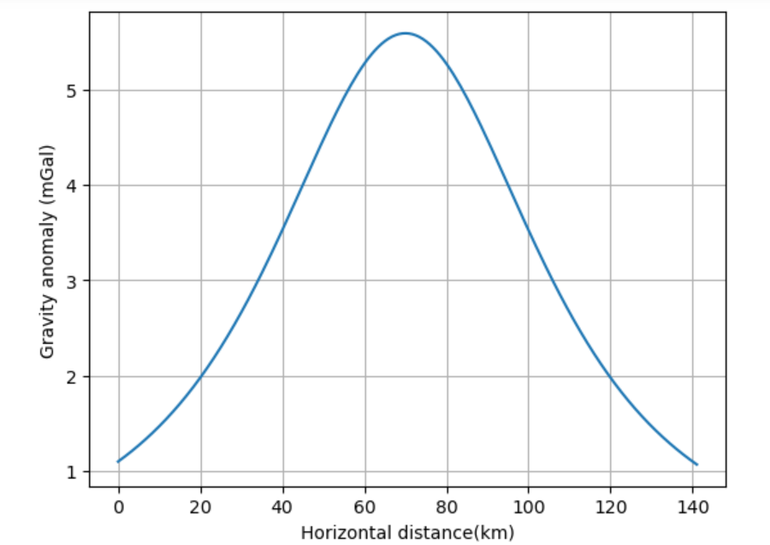
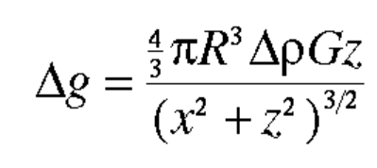
Synthetic gravity anomaly for spherical shaped body
Density contrast( ∆ρ)=500 kg/m^3
Depth(z)=50 km
Radius(R)=10 km

Slide 5
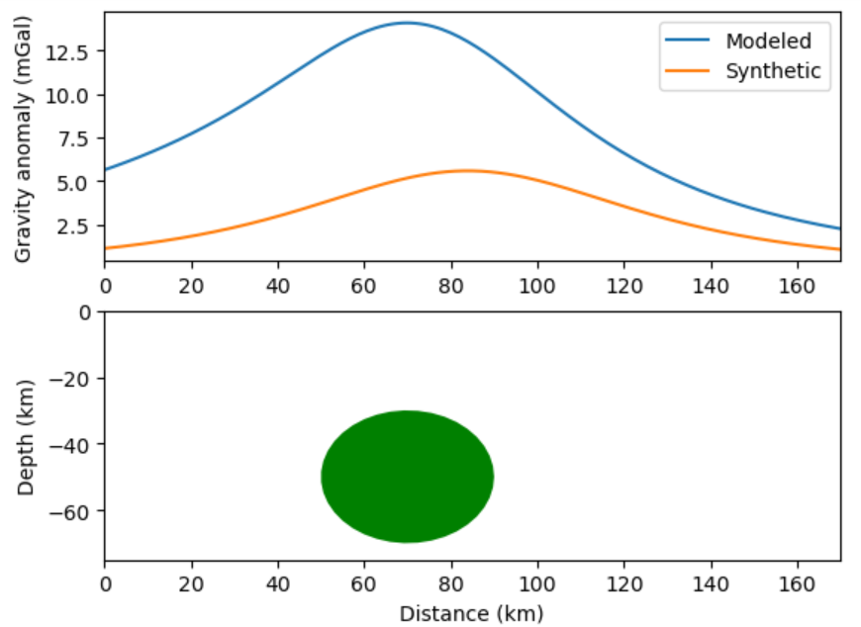
Synthetic vs. Modeled

Slide 6
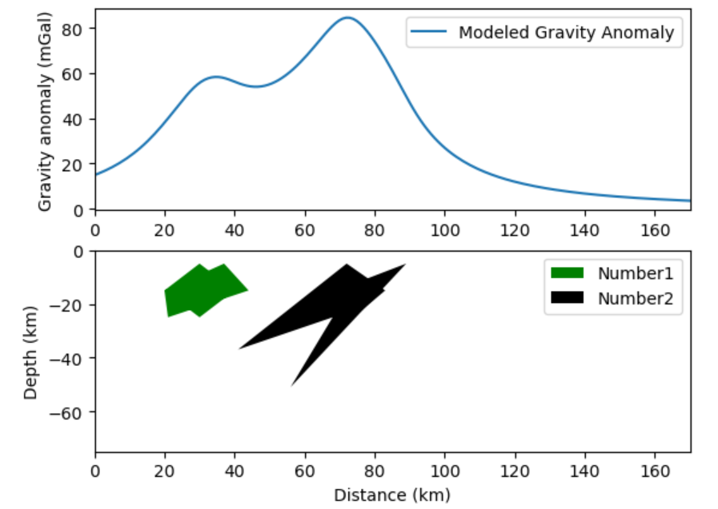
Anomaly for arbitray shaped bodies

Slide 7
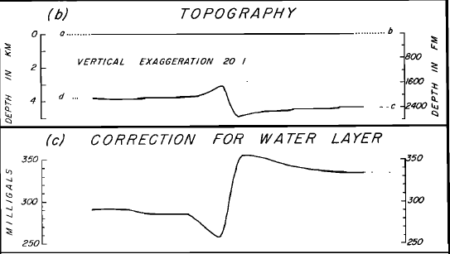
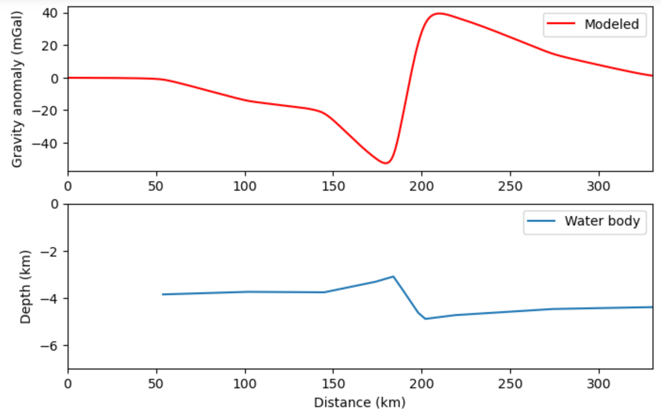
Gravity anomaly for a water table :
Density contrast between water and underlain rock = 1810 kg /m^3
Data from : Paper by Talwani et al.

Slide 8
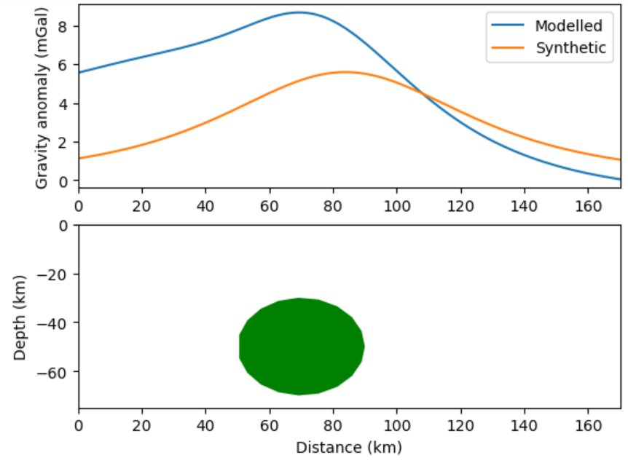
Accuracy depends on the shape of the polygon
Data points used = 40
Data points used = 20
Pearson correlation coefficient=0.824
Pearson correlation coefficient=0.597

Slide 9
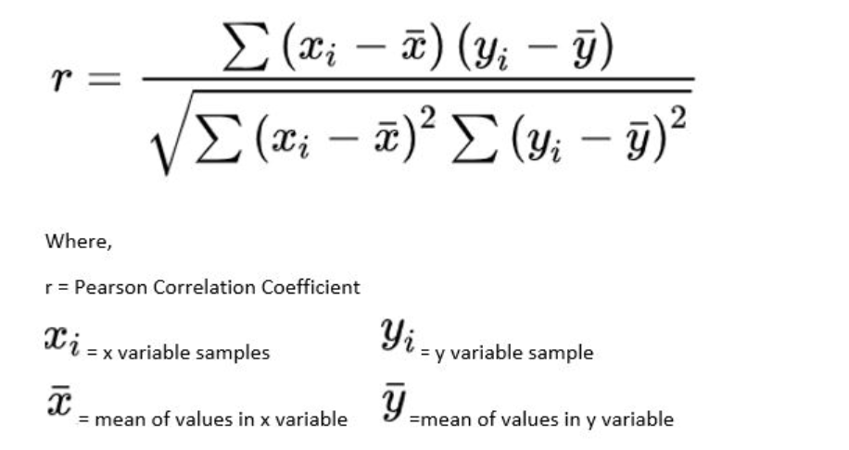
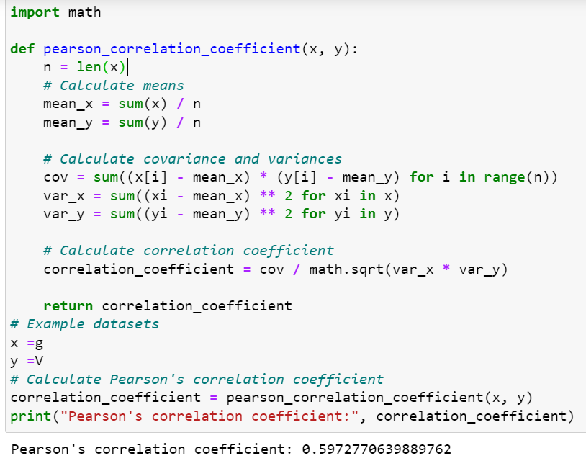
Pearson correltion coefficient

Slide 10

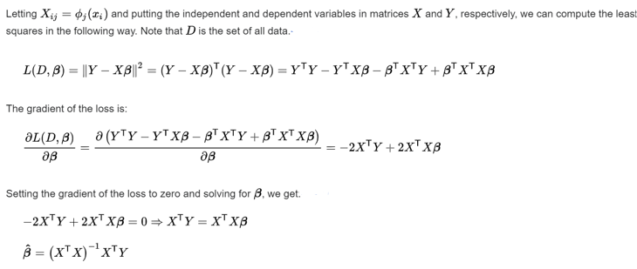
Inversion of a real gravity data using Least-square method

Slide 11
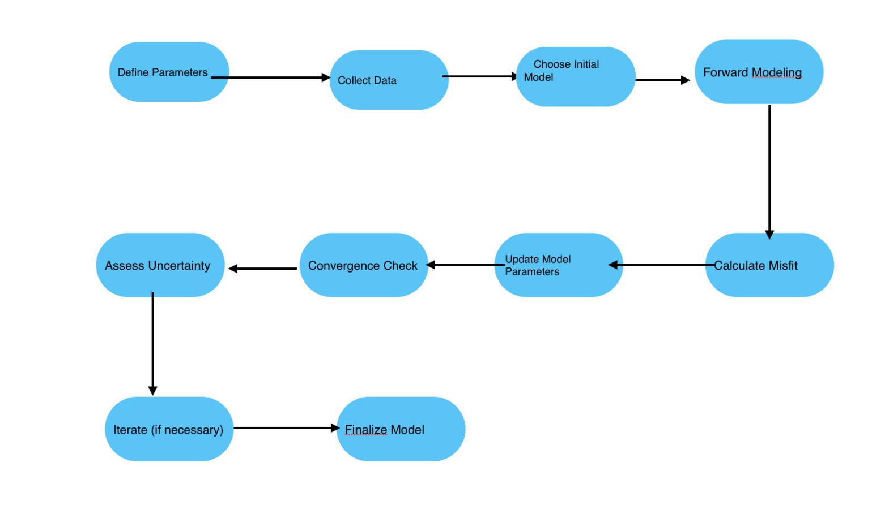
Flowchart for least-square Inversion

Slide 12
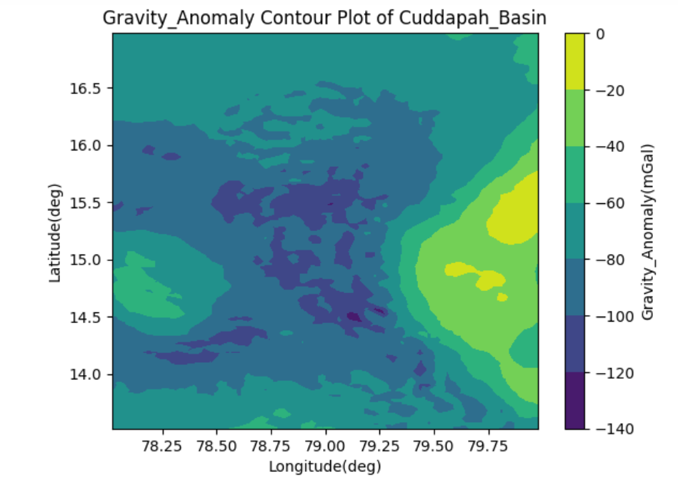
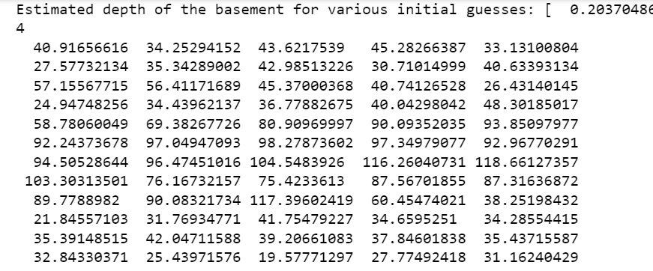
Estimated depth for various initial guess

Slide 13
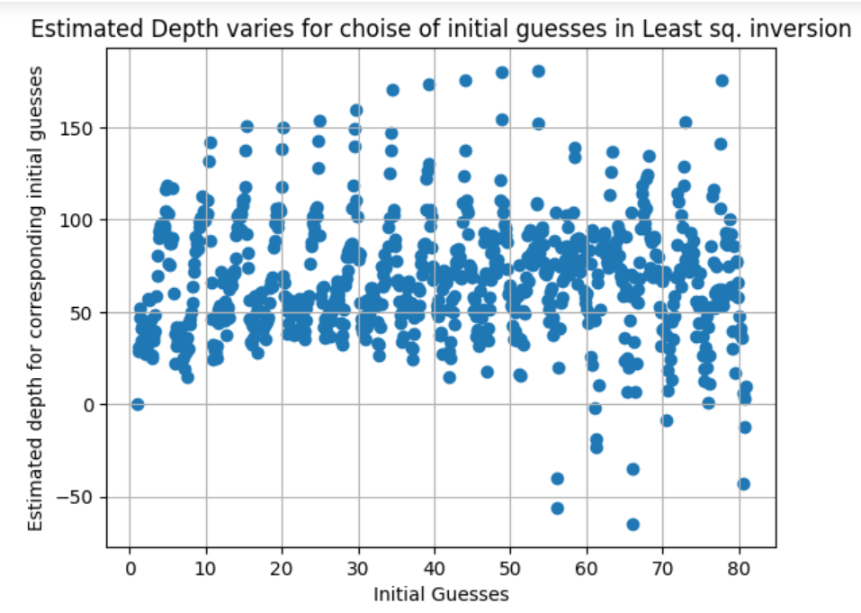
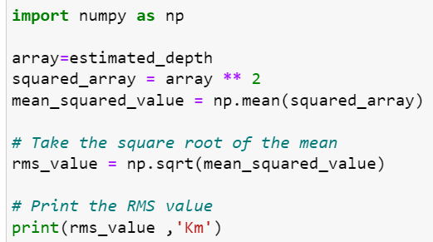

Slide 14
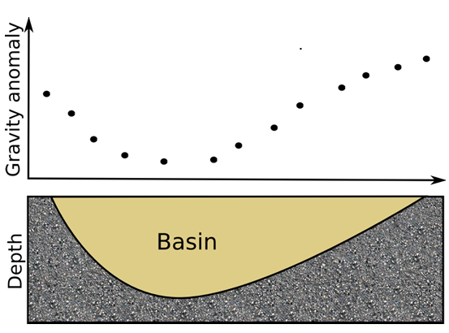
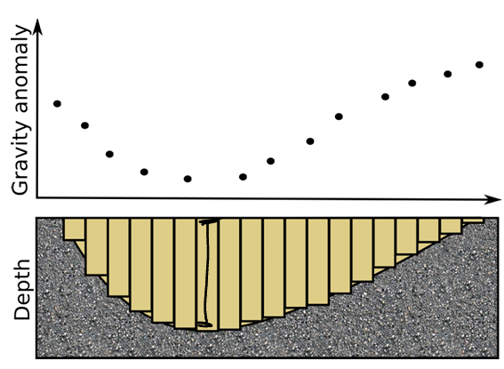
Non-linear Gravity Inversion of synthetically generated data for a sedimentary basin
By inversion we compute the depth of the prisms that best fits the observed gravity anomaly.

Slide 15
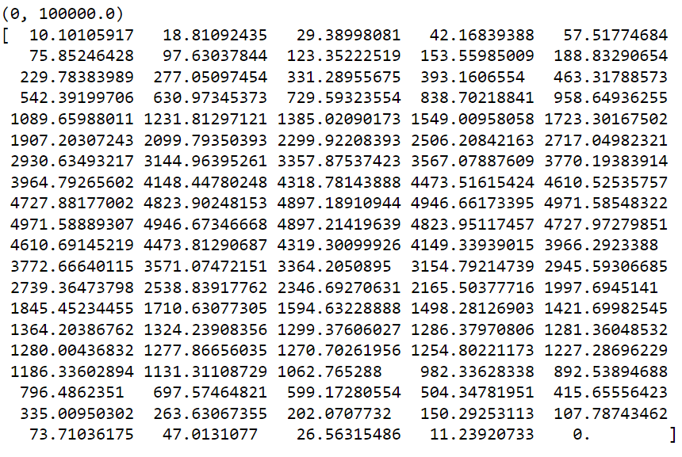
Synthetically generated data of the basin

Slide 16
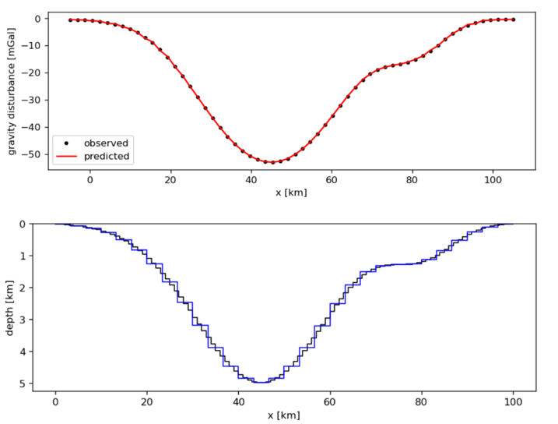
Comparison between observed and predicted gravity anomaly

Slide 17
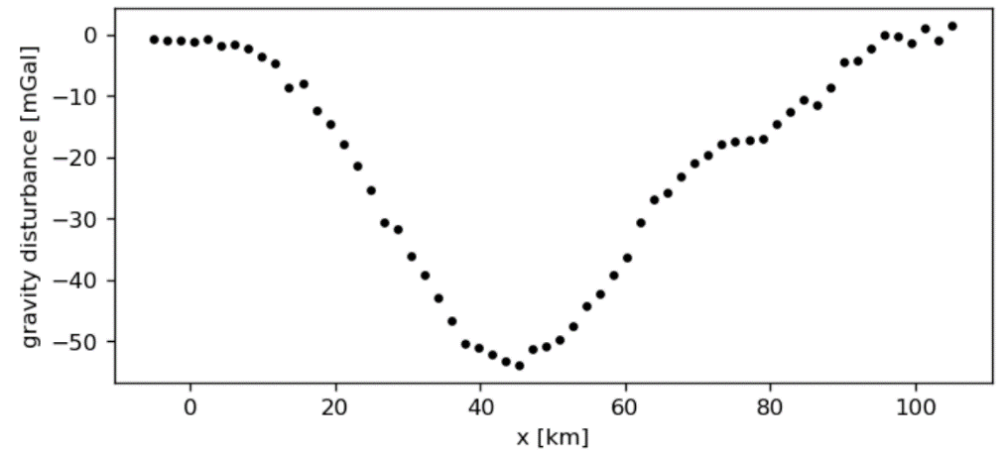
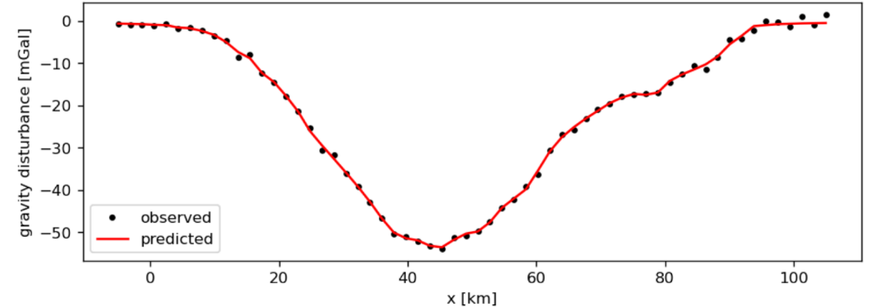
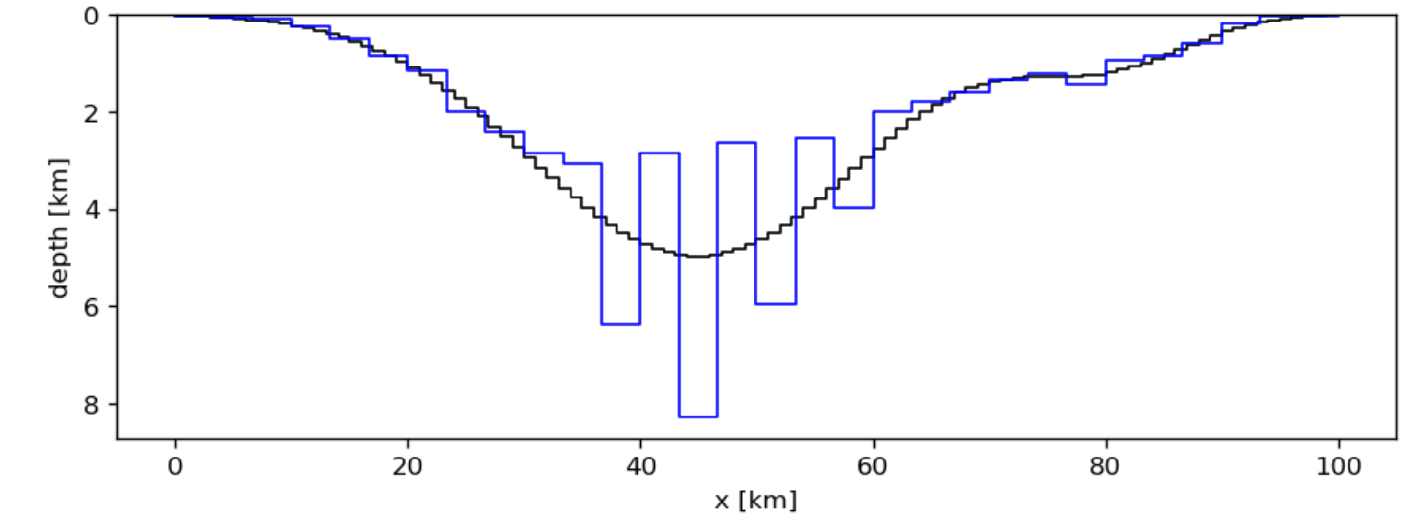
Effect of addition of noise

Slide 18
References
1. “Rapid Gravity Computations for Two-Dimensional Bodies with Application to the Mendocino
Submarine Fracture Zone” by MANIK TALWANI, J L AMAR WORAZEL AND MARK LANDISMAN
2. google.com
THANK YOU

